Slide 1


Slide 2
GHULAM MUSTAFA TARIQ
MUHAMMAD SHAHZAIB
MUHAMMAD ASIF
ALI TAIMOOR
TAYYAB AKRAM
GROUP MEMBERS
1
4
2
5
3

Slide 3
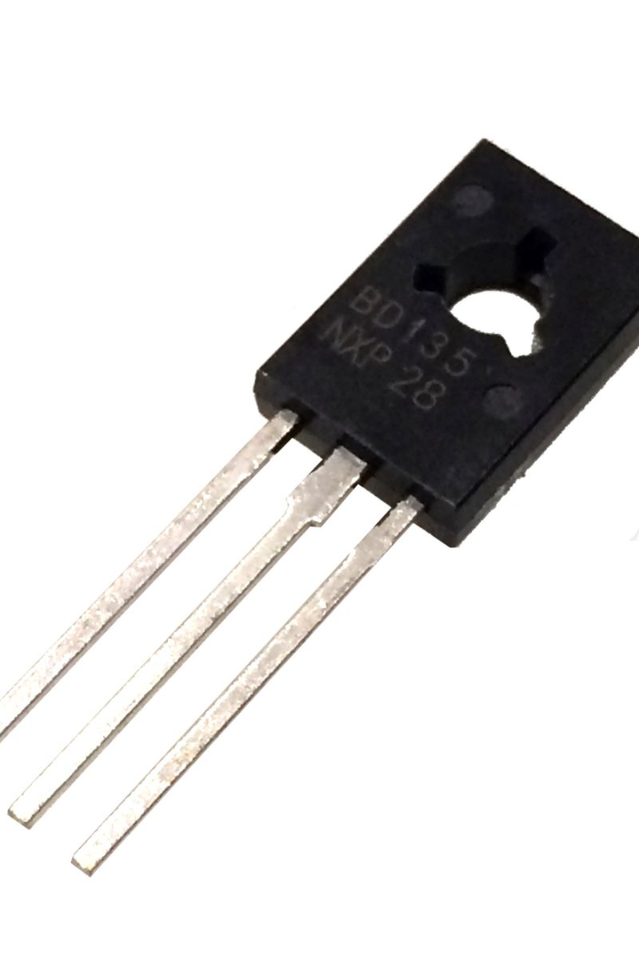
Transistors as Switches
Discover the fascinating world of transistors and their role as switches in electronic circuits. Learn about different types and their applications.

Slide 4
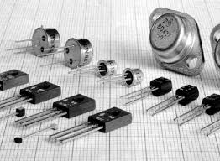
Introduction to Transistors
A transistor is a semiconductor that amplifies or switches electronic signals.
Transistors serve as the basic building blocks of modern electronics.
Transistors are made of materials like silicon or germanium that are capable of allowing electrical current to flow through them in a controlled manner
What is a Transistor?

Slide 5
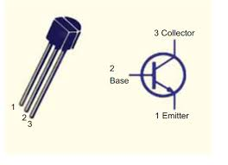
BIPOLAR JUNCTION TRANSISTORS FIELD EFFECT TRANSISTORS INSULATED GATE BIPOLAR TRANSISTORS
BIPOLAR TRANSISTORS:
A bipolar transistor is a type of transistor that uses both electrons and holes as charge carriers.
STRUCTURE OF BJT: 1.COLLECTOR:
Injects majority charge carriers (electrons for NPN).
2.EMITTER:
Controls the flow of charge carriers. 3.BASE:
Collects charge carriers that pass through the base.
TYPES OF TRANSISTORS

Slide 6
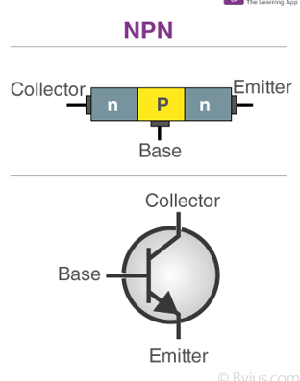
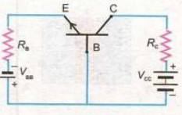
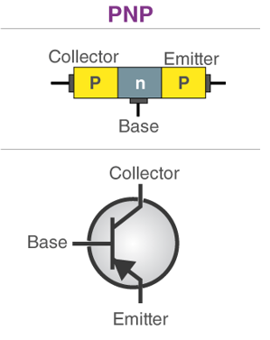
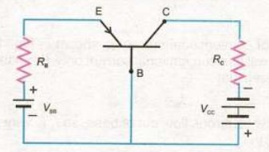
1.IT TURNS ON WHEN ELECTRONS 1. IT TURNS ON WHEN HOLES
ENTER INTO BASE. ENTER INTO BASE.
2.MAJORITY CHARGE CARRIERS 2. MAJORITY CHARGE CARRIERS ARE ELECTRONS. ARE HOLES.
3.GROUND SIGNAL IS LOW. 3.GROUND SIGNAL IS HIGH.
NPN TRANSISTOR
PNP TRANSISTOR

Slide 7
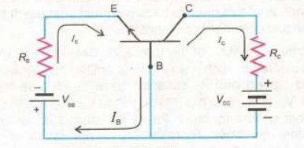
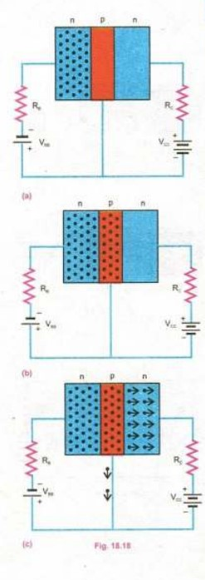
CURRENT IN NPN TRANSISTORS
Current in emitter is
called IE.
Current in collector is called IC.
Current in base is called IB.
Emitter is forward biased.
Collector is reverse biased.
PATH OF ELECTRONS:
Emitter BASE(5%) COLLECTOR

Slide 8
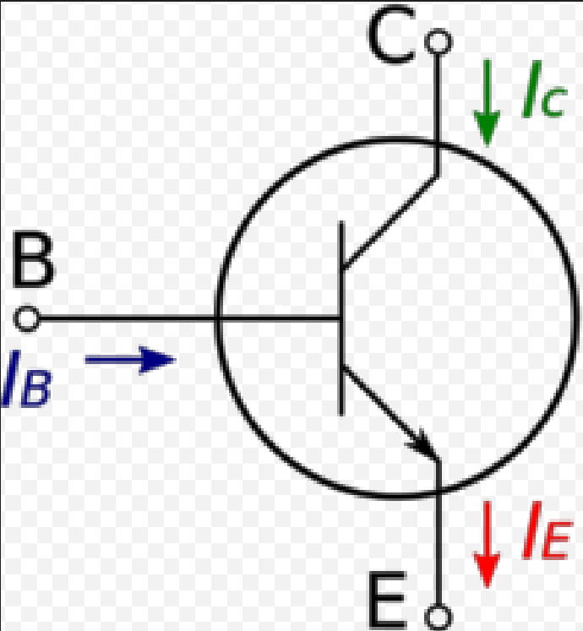
In electronic circuits, the transistors is used to switch on and off the circuits.
E and C are used as terminals of switch.
B and E are used as central terminal.
TRANSISTORS AS A SWITCH

Slide 9
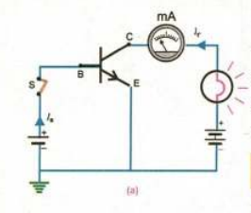
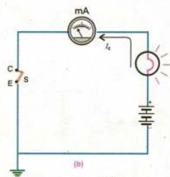

V
CUTT OFF REGION SATURATION REGION
(SWITCH OFF) (SWITCH ON)
SATURATION REGION:
A large voltage is applied across central terminals B and E.
A large $I_{b}$ is injected through the base.
There is very small resistance across C and E to get large current $I_{c}.$
Emitter is at ground so we consider that collector is also at ground.
$I_{c}=βI_{b}$ $∴β=20−200$
WORKING OF TRANSISTOR AS SWITCH

Slide 10
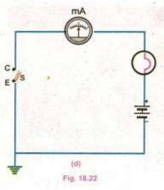
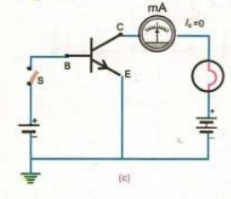

CUTT-OFF REGION:
If base current is zero then $I_{c}$become zero.
If current is zero then resistance become infinite.
$I_{c}=βI_{b}$
$I_{c}=0$ $∴I_{b}=0$
RESISTANCE: $R_{c}=\frac{V_{CE}}{I_{c}}$
$R_{c}=\frac{V_{CE}}{0}$
$R_{c}=∞$

Slide 11
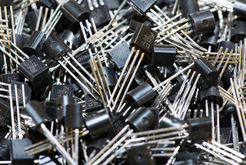
ADVANTAGES OF TRANSISTOR AS A SWITCH
Speed:
Transistors switch on and off quickly, crucial for fast operations in digital circuits.
Size:
Small and lightweight, transistors can fit into compact spaces, ideal for portable devices.
Low Power Consumption:
They use very little power when in the off state, promoting energy efficiency.
Precision:
Transistors provide precise control over the flow of current,
essential for various applications.
1
2
3
4

Slide 12
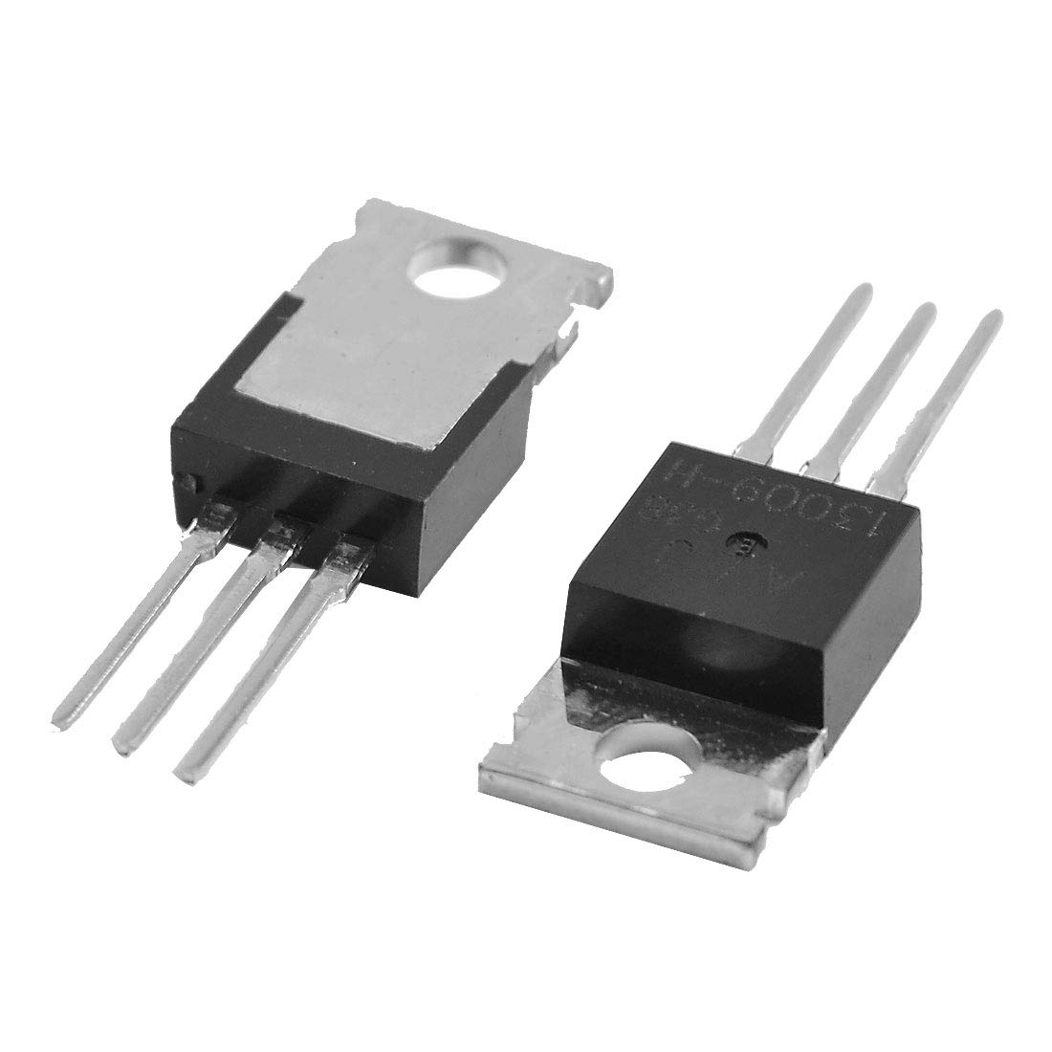
Versatility:
Suitable for a wide range of applications, from simple switches to complex digital systems.
Reliability:
Solid-state design results in high reliability and durability with no moving parts.
Digital Logic:
Integral to digital logic circuits, forming the foundation of computers and digital devices.
Temperature Stability:
Perform consistently across different temperatures, ensuring reliability.
Cost-Effective:
Affordable to manufacture, making them widely accessible for various applications
5
6
7
8
9

Slide 13
DISADVANTAGES OF TRANSISTOR AS A SWITCH
Heat Generation:
Transistors generate heat during switching, which can be a concern in high-power applications, necessitating cooling measures.
Saturation Voltage:
Transistors exhibit a saturation voltage, leading to power loss, particularly in low-power scenarios where minimizing energy consumption is crucial.
Switching Speed:
While transistors can switch rapidly, there are limitations, especially in high-frequency applications, where inherent capacitances and resistances can introduce delays.
Breakdown Voltage:
Transistors have a maximum voltage rating, and exceeding this limit may cause breakdown or failure, emphasizing the need to consider application voltage requirements.
1
2
3
4

Slide 14
Current Limitations:
Exceeding the maximum current ratings of transistors can lead to overheating and potential damage, requiring consideration in high-power setups.
Sensitivity to Temperature:
Transistor characteristics are temperature-sensitive, introducing variations in performance, especially in environments with temperature fluctuations.
Manufacturing Variability:
The manufacturing process introduces variability in transistor characteristics, requiring careful testing and selection for specific applications, particularly in precision circuits.
Cost:
The cost of transistors and associated circuitry may be a consideration, especially in applications where cost is a critical factor.
5
6
7
8

Slide 15
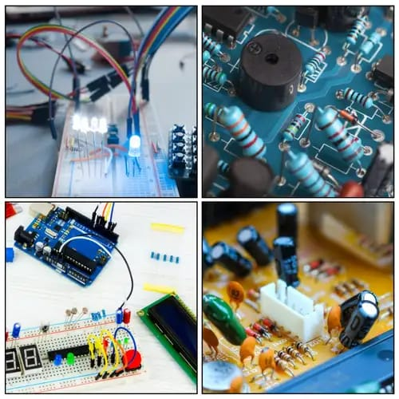
APPLICATIONS OF TRANSISTORS AS A SWITCH
1
Digital Electronics :
The building blocks of digital circuitry and transistors serve as switches inside logic gates and are crucial for creating complex systems like microprocessors and memory units in computers and smartphones..
2
Power Supplies :
They serve as switching regulators in power supplies. Transistors effectively control the current flowing via power circuits, transforming voltage levels and guaranteeing effective power provision.
3
Amplifiers :
In audio amplifiers, transistors function as switches that control the flow of current to amplify weak signals without distortion, thus providing a larger output signal compared to the input.

Slide 16
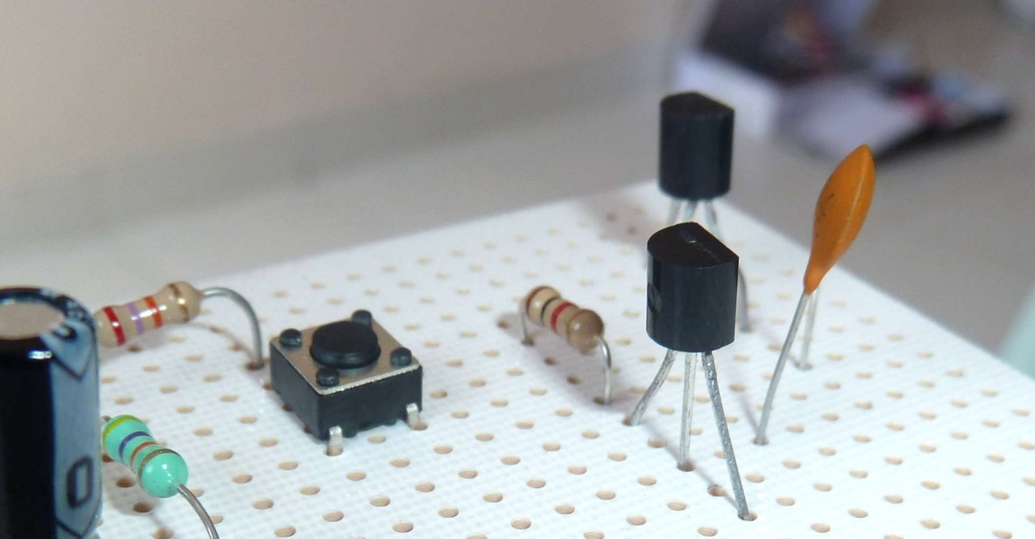
Lighting Control:
Transistors are used in dimmer switches and lighting control systems. By regulating the flow of current to light sources, they control the brightness of bulbs or LEDs in various applications.
Motor Control:
Transistors act as switches in motor control circuits. They regulate the current flow to control the speed and direction of motors in various devices such as fans, pumps, and robotics.
Telecommunications:
Transistors are used in communication systems to switch and amplify signals in radio frequency (RF) circuits, enabling the transmission and reception of data in devices like cell phones and radios.
4
5
6

Slide 17


Slide 18


